Slide 1


Non-Invasive GlucoHaemo Meter PAIN GAIN

Slide 2
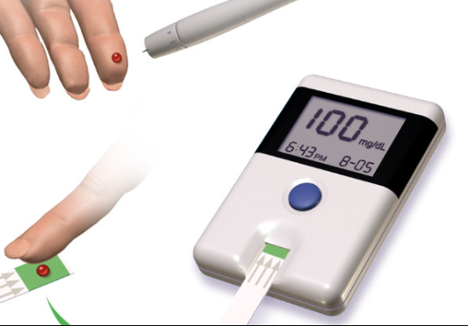
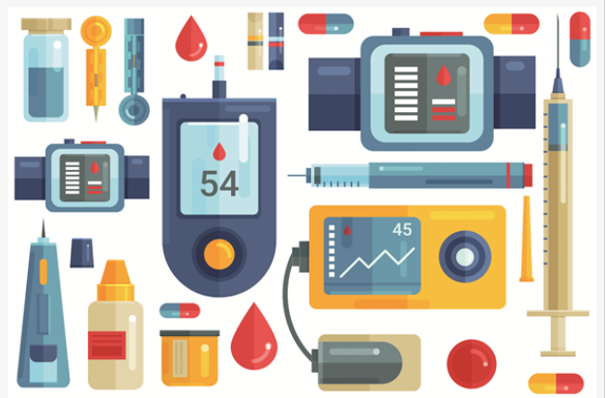
PROBLEM
Difficulties faced by Diabetic and Anaemic patients in monitoring their blood glucose and haemoglobin levels using invasive devices which cause pain and also some of them are time taking.

Slide 3
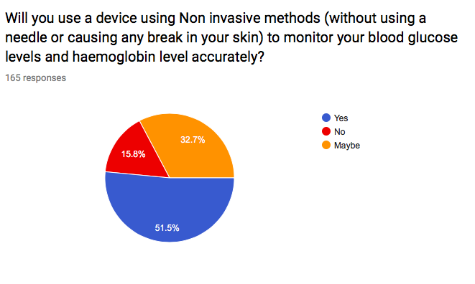

Slide 4
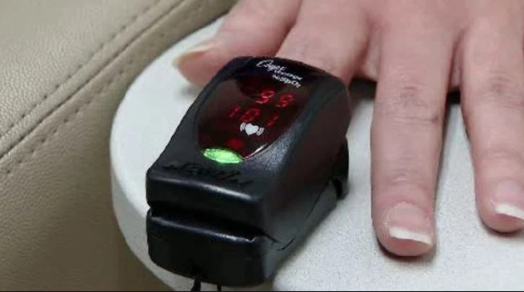
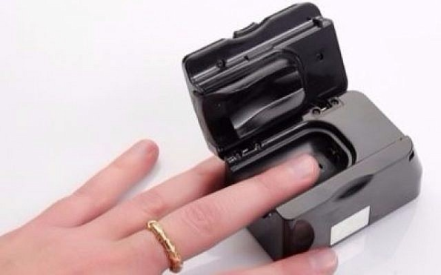
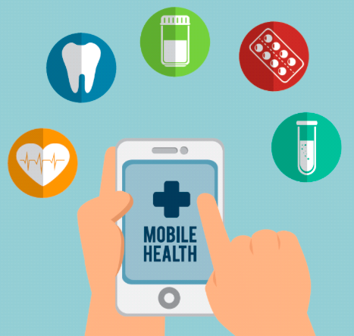
SOLUTION
A portable , easy to use Non Invasive device which monitors Glucose and haemoglobin levels of a person accurately

Slide 5

PRODUCT
Our product is a low cost app which monitors the Hemoglobin levels accurately without using a needle or causing a break in the skin just where the user just needs to upload his/her photo.
Along with features of portability, ease of use.

Slide 6
TECHNOLOGY STACK
Image Processing
Regression Analysis
Android Studio

Slide 7
Market Research
We enquired and got to know about their views on our project from the following Health care centres
Dr.Nirmala,KIMS hospital,Minister Road
ESI Hospital, Ramachandrapuram
Sri Sai Krupa labs, Moosapet
ESI hospital,Erragadda
Care and cure Hospitals , Nizampet

Slide 8
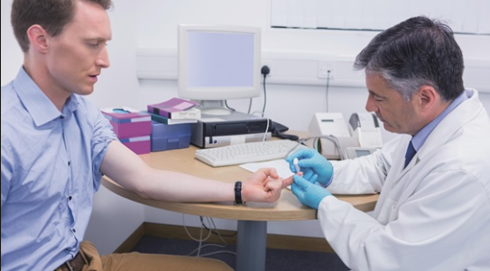
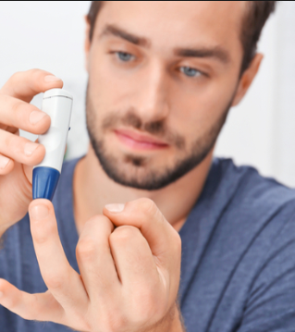
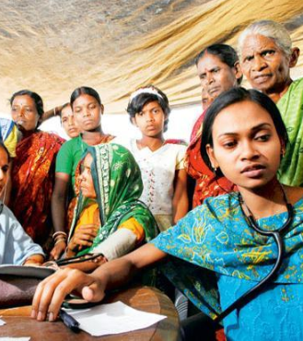
MARKET
Our customers are Diabetic & Anemic patients ,PHC's, Rural Health Care centers
Prospective Customers are Diabetic and Anemic patients in urban area for now
We can address the patients nearby our locality.

Slide 9
VALUE PROPOSITION
No pain
Saves time
Patient friendly
Wellness
Low cost

Slide 10
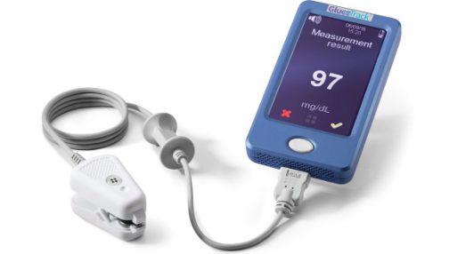
COMPETITORS
DiaMonTech is a German company which is working on the Non Invasive Glucometer and it is yet to be released in the German market
Non Invasive GlucoTrack device by Integrity company

Slide 11
MARKETING STRATEGY
Targeted Customers
Diabetic and Anemic patients
PHC's
Channels
Through hospitals and diagnostic centers
Through Pharmaceutical stores and retailers.
Through advertisements and posters online
Diagonostic Centers

Slide 12
Financials
Hemoglobin measurement can be done using the help of our app for free for the first 3 tests and then after they need to pay an amount of 80/- per each measurment.
A collaboration with diagnostic centers providing them a discount so that they could be profited and draw many patients to our service.
Advertisements of hospitals and medical devices in our app.

Slide 13
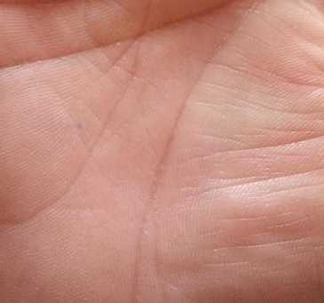
Status
We are able to find the haemoglobin values and this need to be converted into an app which is in progress.
We are able to get values of the glucose levels but they are not accurate we have to fix that issue.

Slide 14
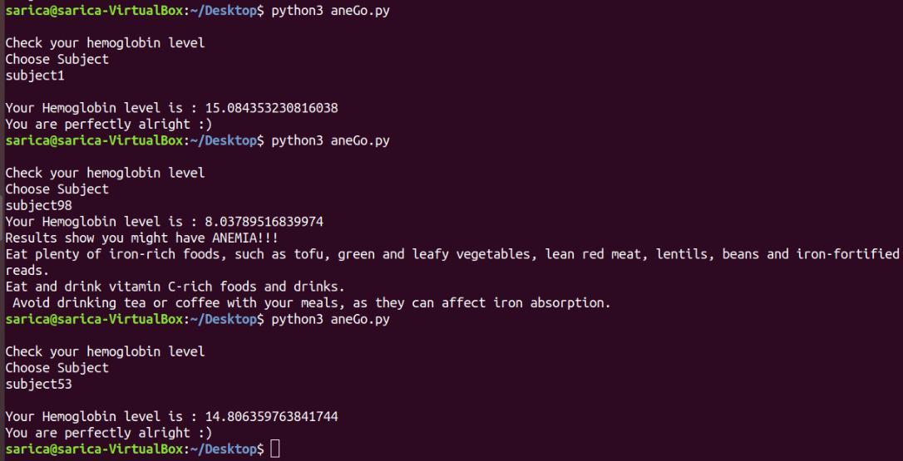

Slide 15
Team
M.Sarica(Team Lead)
Qualification: B.Tech 2nd year , ECE
N.Sai Chandana
Qualification: B.Tech 2nd year , ECE
C.Jahnavi Sai Sirisha
Qualification: B.Tech 2nd year , ECE
M.Sai Preethi
Qualification: B.Tech 2nd year , ECE

Slide 16
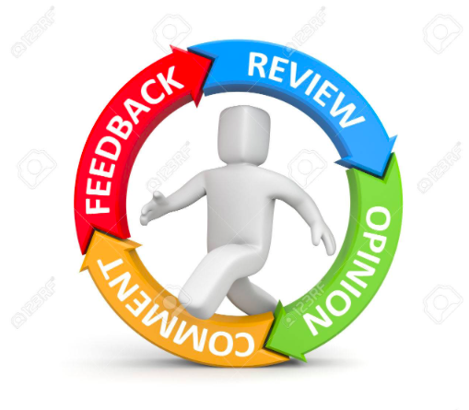
Queries

Slide 17
THANK YOU

